Slide 1

The National University of Computer and Emerging Sciences
Natural Language Processing
Deep Learning
Dr. Qurat Ul Ain
Department of AI & DS

Slide 2

Introduction to natural language processing
Notes:
© Copyright Showeet.com – Free PowerPoint Templates

Slide 3

INPUT
OUTPUT

Slide 4
Learning Objective of this Topic
What is NLP? (Definition)
Need of NLP (Motivation)
Types of NLP
Application/Tasks of NLP
Components of NLP
NLP used by
End-to-End Pipeline of NLP

Slide 5
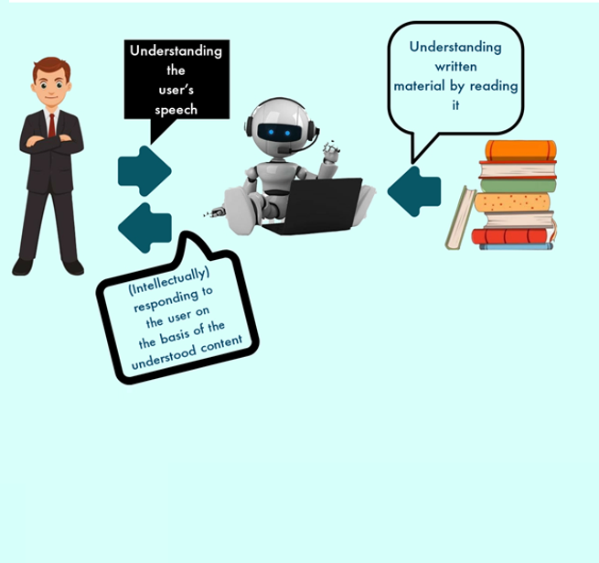
What is nlp?

Slide 6

Definition (NLP)
Natural language processing (NLP) is a subfield of linguistics, computer science, and artificial intelligence concerned with the interactions between computers and human language, in particular how to program computers to process and analyze large amounts of natural language data.
The goal is a computer capable of "understanding" the contents of documents, including the contextual nuances of the language within them. The technology can then accurately extract information and insights contained in the documents as well as categorize and organize the documents themselves.
Challenges in natural language processing frequently involve speech recognition, natural-language understanding, and natural-language generation.
-Wikipedia

Slide 7
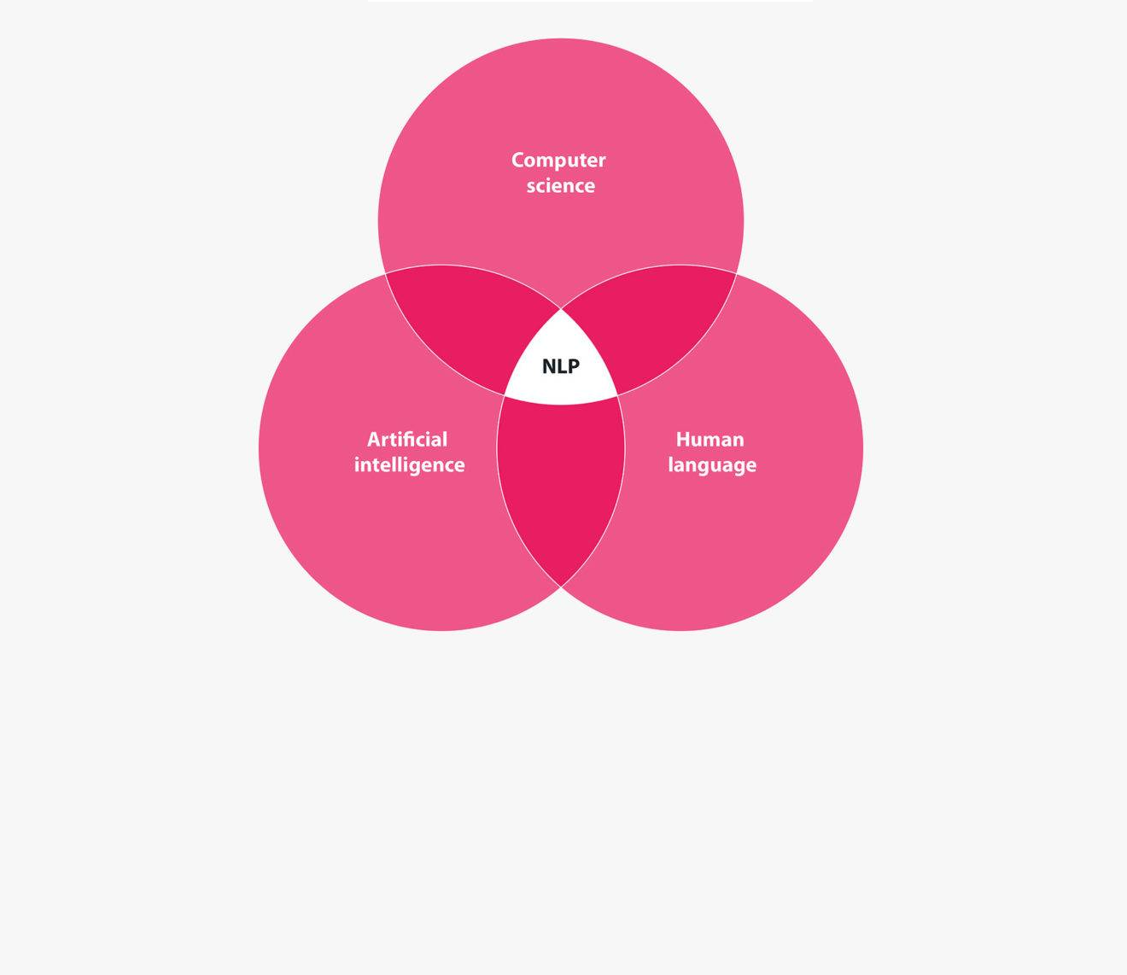
NEED of nlp

Slide 8

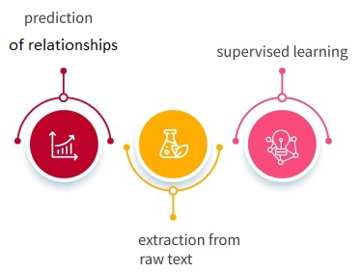
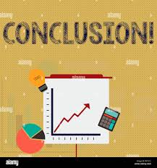
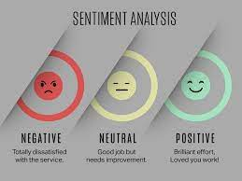
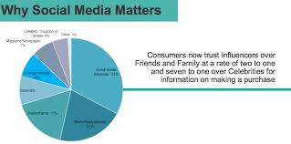
Increasing- Content Handling
Automation of Knowledge Extraction
NLP
Concluding A Decision
Assessment of Content
Influential Content

Slide 9
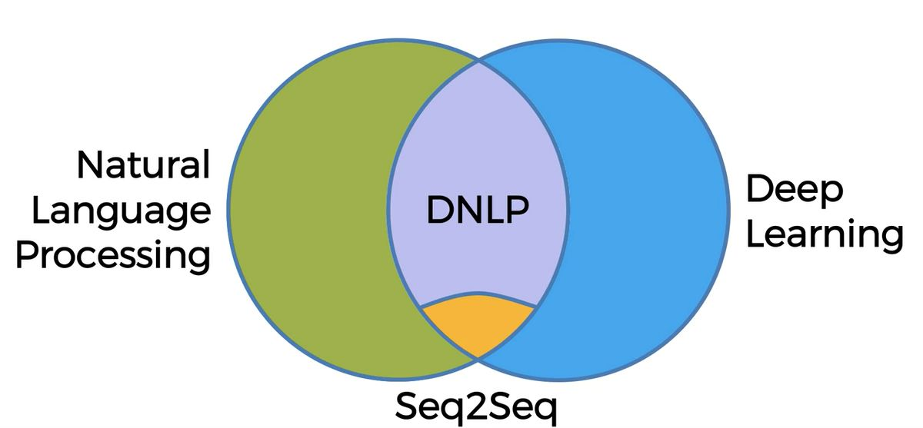
TYPES of nlp

Slide 10
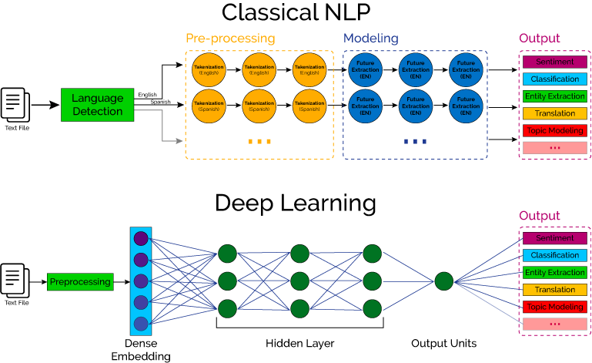

Slide 11
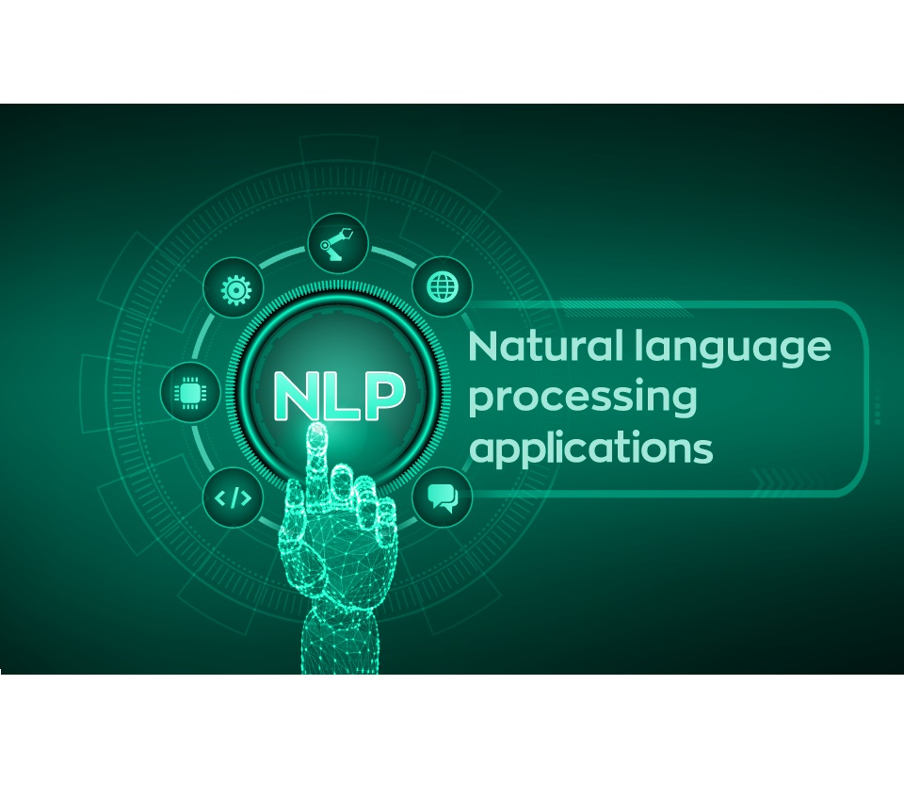
APPLICATIONS/Tasks of nlp

Slide 12
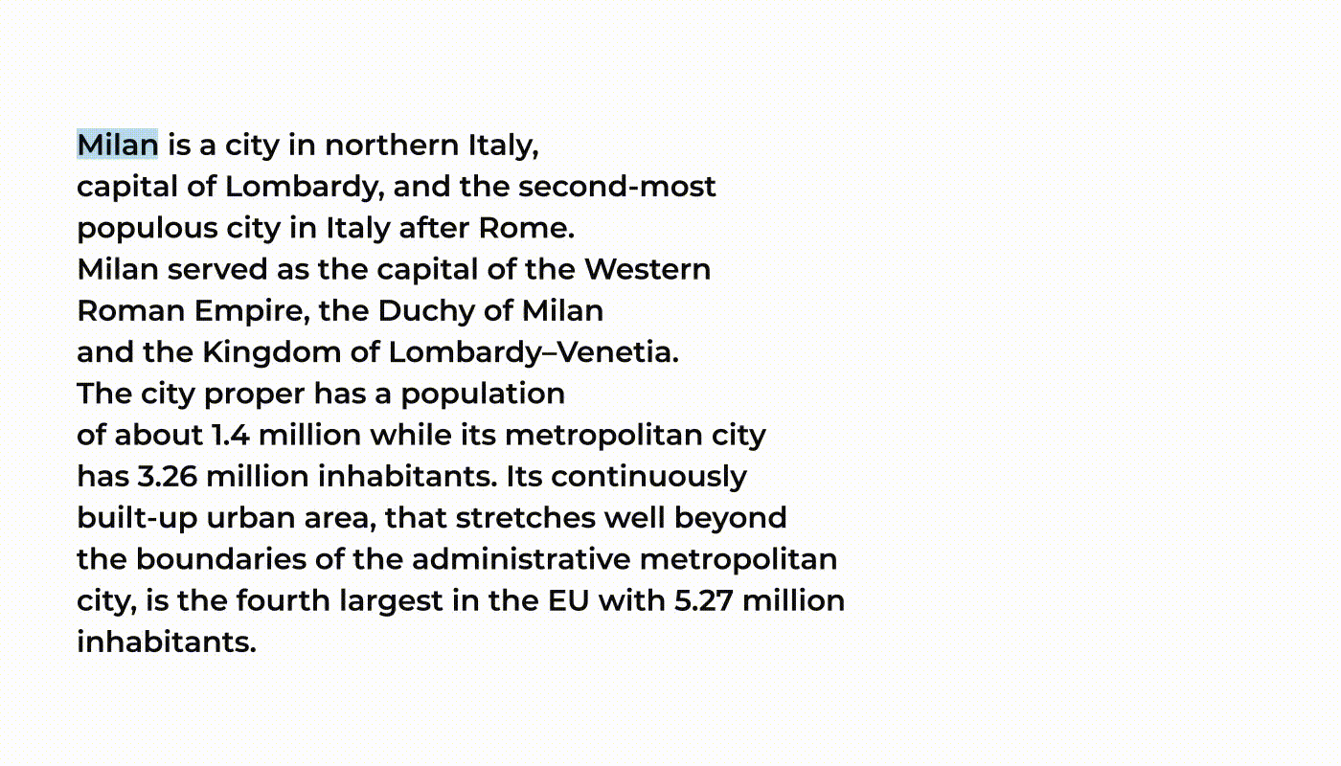


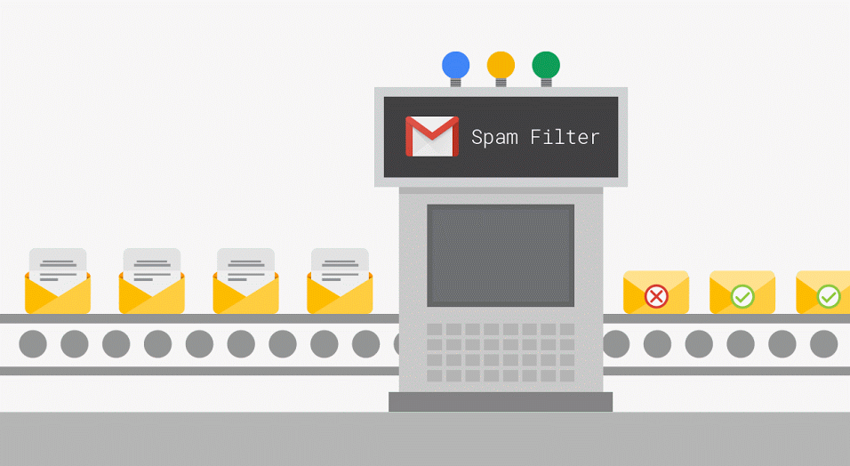


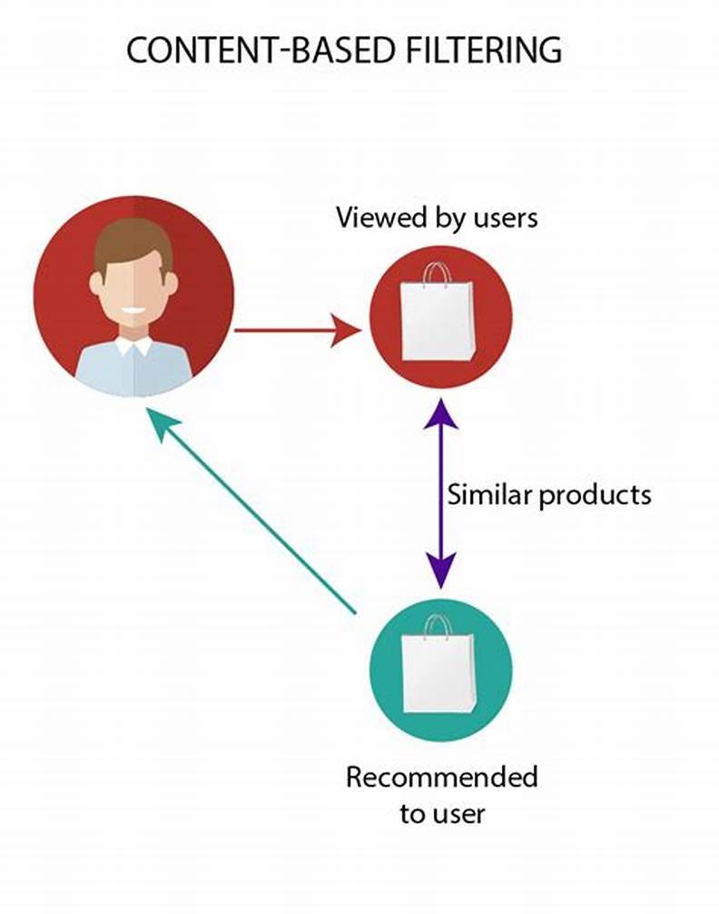


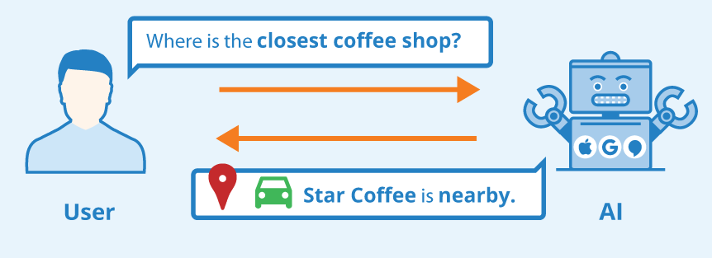

‽
NLP
Information Retrieval
Machine Translation
Email Filtering
Speech Transcription
Sentiment Analysis
Content Filtering and Recommendation
Text Summarization
Question Answering
ChatBots
Contextual Advertisement

Slide 13
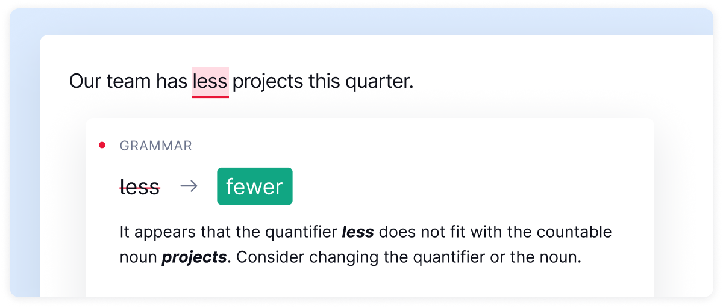
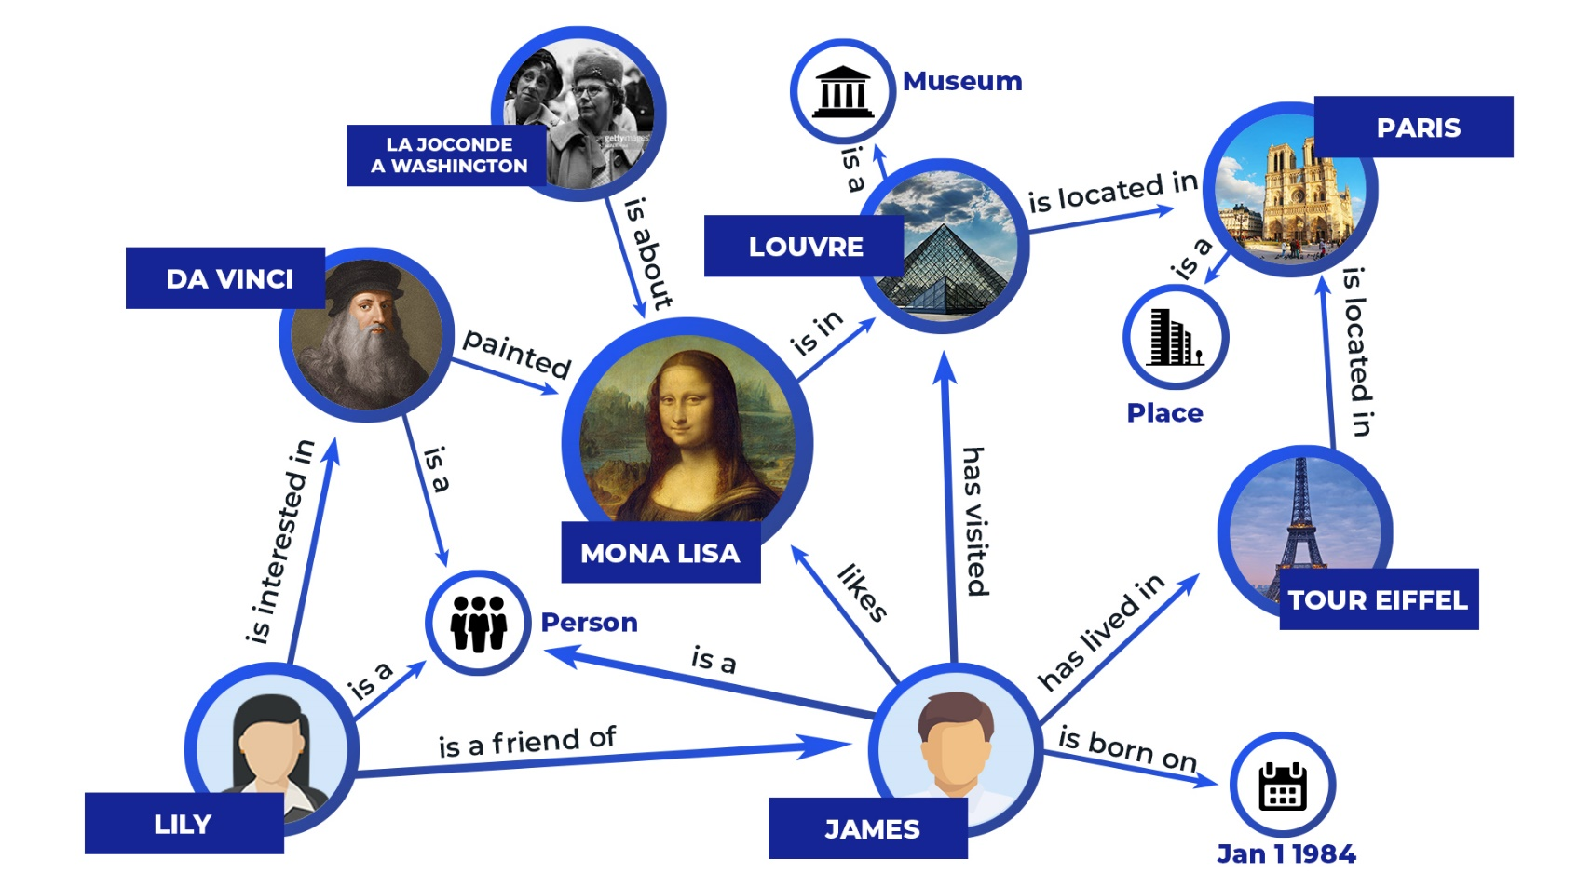
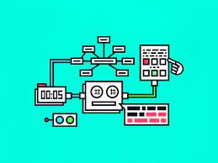
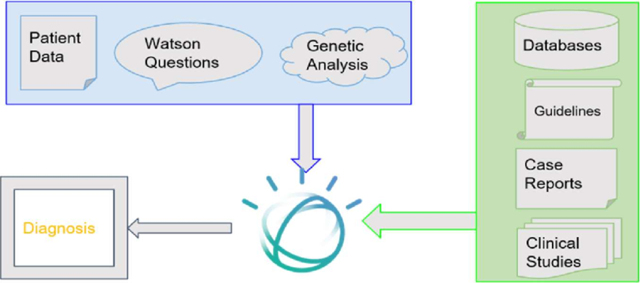
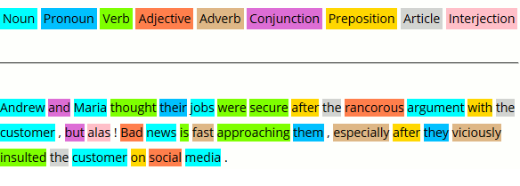
‽
NLP
Spelling Checking –Grammar Correction
Knowledge Graphs
Medical Report Analysis and Prediction
Text Generator (Jenny.ai, ChatGPT and …)
POS Tagging

Slide 14
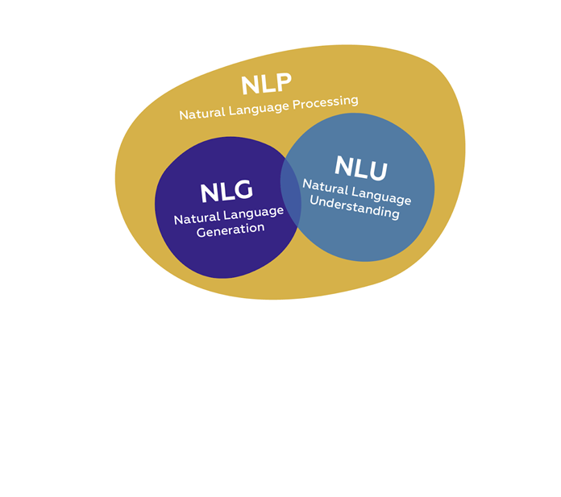
COMPONENTS OF NLP

Slide 15
Natural Language Understanding
Natural Language Understanding (NLU) helps the machine to understand and analyze human language by extracting the text from large data such as keywords, emotions, relations, semantics, etc.
Mapping input to useful representations
Analyzing different aspects of the language
It plays a crucial role in bridging the gap between human communication and machine understanding
NLU has numerous applications, such as virtual assistants, chatbots, sentiment analysis tools, language translation systems, information retrieval systems, and more

Slide 16
Natural Language Generation
NLG is concerned with generating natural language. It uses a machine representation system like a knowledge base or a logical form. You can think of it as a translator between data and natural language representation; this is the opposite of NLU. This involves three tasks-
Text Planning- To extract relevant content from the knowledge base.
Sentence Planning- To choose appropriate words, form meaningful phrases, and set sentence tone.
Text Realization- To map the sentence plan into sentence structure.
NLG has numerous applications, such as ChatGPT, recommender system, personalized communication, business intelligence, more

Slide 17

NLP uSED BY

Slide 18


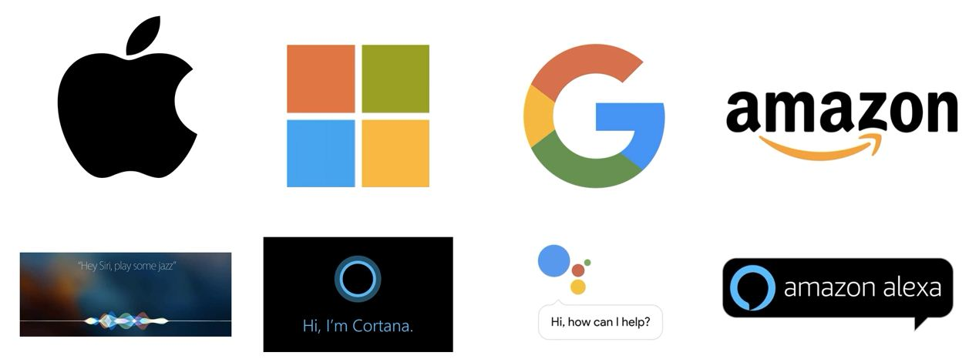
Notes:
NLP is how voice assistants, such as Siri and Alexa, can understand and respond to human speech and perform tasks based on voice commands.

Slide 19
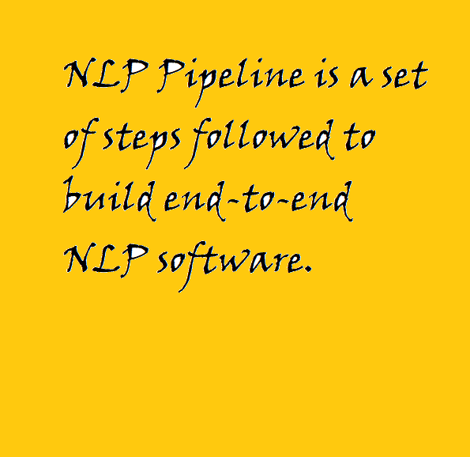
What is End-end nlp Pipeline?

Slide 20

Points to REMEMBER
NLP Pipeline is not Universal.
Vary from task to task.
Deep Learning Pipelines are slightly different.
NLP Pipeline is not linear.
Notes:
Key Takeaways from the Slide:
NLP Pipeline is not Universal
There is no single, fixed pipeline that works for all NLP tasks. Different tasks (like sentiment analysis, translation, question answering, etc.) may require different approaches and processing steps.
Vary from Task to Task
Depending on the problem (e.g., text classification vs. machine translation), the preprocessing, model selection, and evaluation strategies will vary.
Deep Learning Pipelines are Slightly Different
Traditional NLP pipelines often rely heavily on handcrafted features (tokenization, stemming, POS tagging, etc.).
In deep learning, many steps can be learned automatically by the model (e.g., word embeddings replace manual feature extraction), though preprocessing is still important.
NLP Pipeline is not Linear
The process doesn’t always follow a strict step-by-step order.
You might loop back, iterate, or skip some stages depending on the data, task, and model performance.

Slide 21
STEPS Involved in nlp pipeline
Data Acquisition
Text Preparation
Deployment
Modelling
Feature Engineering

Slide 22
Data Acquisition
Available
Data (Tables)
Database
Others
NoData
Less data
Data Engineering
Data Augmentation
Public Dataset
WebScraping
BeautifulSoup
API
RapidAPI
PDF
Image
Audio
Speech to Text
Synonym
Bigram Flip
Back Translate
Add Noise
Tools
Notes:
1. Data Available
Sources:
Data (Tables) – Structured tabular data.
Database – Large, queryable structured datasets.
Process:
Data Engineering – Cleaning, preprocessing, transforming, and integrating datasets for model use.
🔹 2. Others (Limited Data)
Situation: You have some data, but not enough for effective training.
Solution: Data Augmentation
Synonym Replacement – Swap words with their synonyms.
Bigram Flip – Reorder word pairs to create variation.
Back Translation – Translate to another language and back to generate paraphrases.
Add Noise – Introduce controlled random changes (misspellings, word drops).
Tools – Pre-built augmentation libraries and frameworks.
🔹 3. No Data
Solution: Acquire new data externally
Public Datasets – Pre-collected, freely available datasets.
Web Scraping – Extracting data from websites (with libraries like BeautifulSoup).
APIs – Example: RapidAPI for external data.
Documents & Media – Extract from PDFs, images, audio.
Speech to Text – Convert spoken audio into text for further processing.

Slide 23
Text Preparation
Cleansing
HTML Tags Removal
Basic Preprocessing
Advance Preprocessing
Notes:
1. Cleansing
Goal: Remove unnecessary or irrelevant text artifacts.
Example:
HTML Tag Removal – Clean out <html>, <div>, <p>, etc. when data is scraped from web pages.
Other typical cleansing steps may include removing URLs, emojis, or special characters.
🔵 2. Basic Preprocessing
Goal: Standardize text for analysis.
Common steps include:
Lowercasing text.
Removing stop words (e.g., the, is, at).
Tokenization (splitting sentences into words/tokens).
Removing punctuation and numbers.
🔵 3. Advanced Preprocessing
Goal: Refine text to capture linguistic meaning.
Techniques may include:
Stemming – Reducing words to their root form (e.g., running → run).
Lemmatization – Converting words to their base dictionary form (e.g., better → good).
POS tagging – Identifying part of speech for each token.
NER (Named Entity Recognition) – Identifying entities like names, locations, dates.
Dependency Parsing – Understanding grammar and relationships between words.

Slide 24
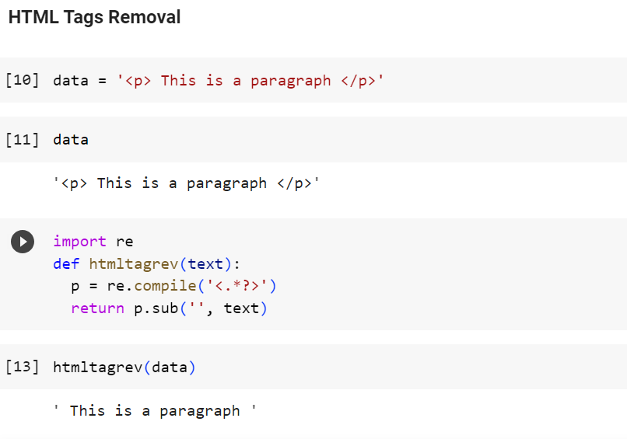
Notes:
re.compile('<.*?>'): Creates a regex pattern to capture everything between < >.
p.sub('', text): Replaces those tags with an empty string (‘’).
htmltagrev is a custom Python function (not a built-in library) that was defined in the code to remove HTML tags from text using regex.
Regex (short for Regular Expression) is a powerful pattern-matching language used to search, extract, and manipulate text based on specific rules.

Slide 25
Text Preparation
Cleansing
HTML Tags Removal
Emoji
Basic Preprocessing
Advance Preprocessing

Slide 26
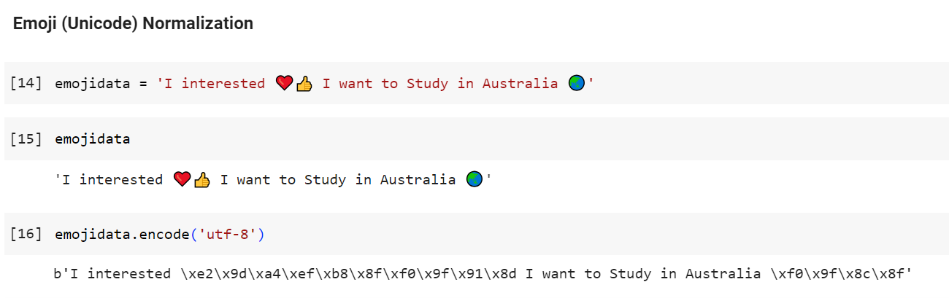
Notes:
Converts the text into bytes, encoding every character (including emojis) in UTF-8.

Slide 27
Text Preparation
Cleansing
HTML Tags Removal
Emoji
Basic Preprocessing
Advance Preprocessing
Spelling Checker

Slide 28
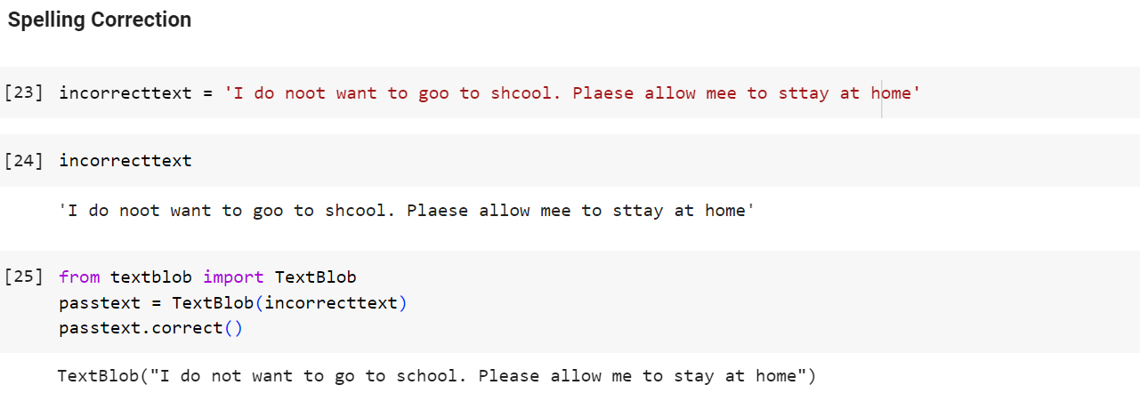
Notes:
TextBlob is a Python library for NLP tasks like spelling correction, sentiment analysis, and translation. Alternative : pyspellchecker (faster, dictionary-based):

Slide 29
Text Preparation
Cleansing
HTML Tags Removal
Emoji
Basic Preprocessing
Advance Preprocessing
Spelling Checker
Basic
Tokenization
Word
Sentence

Slide 30
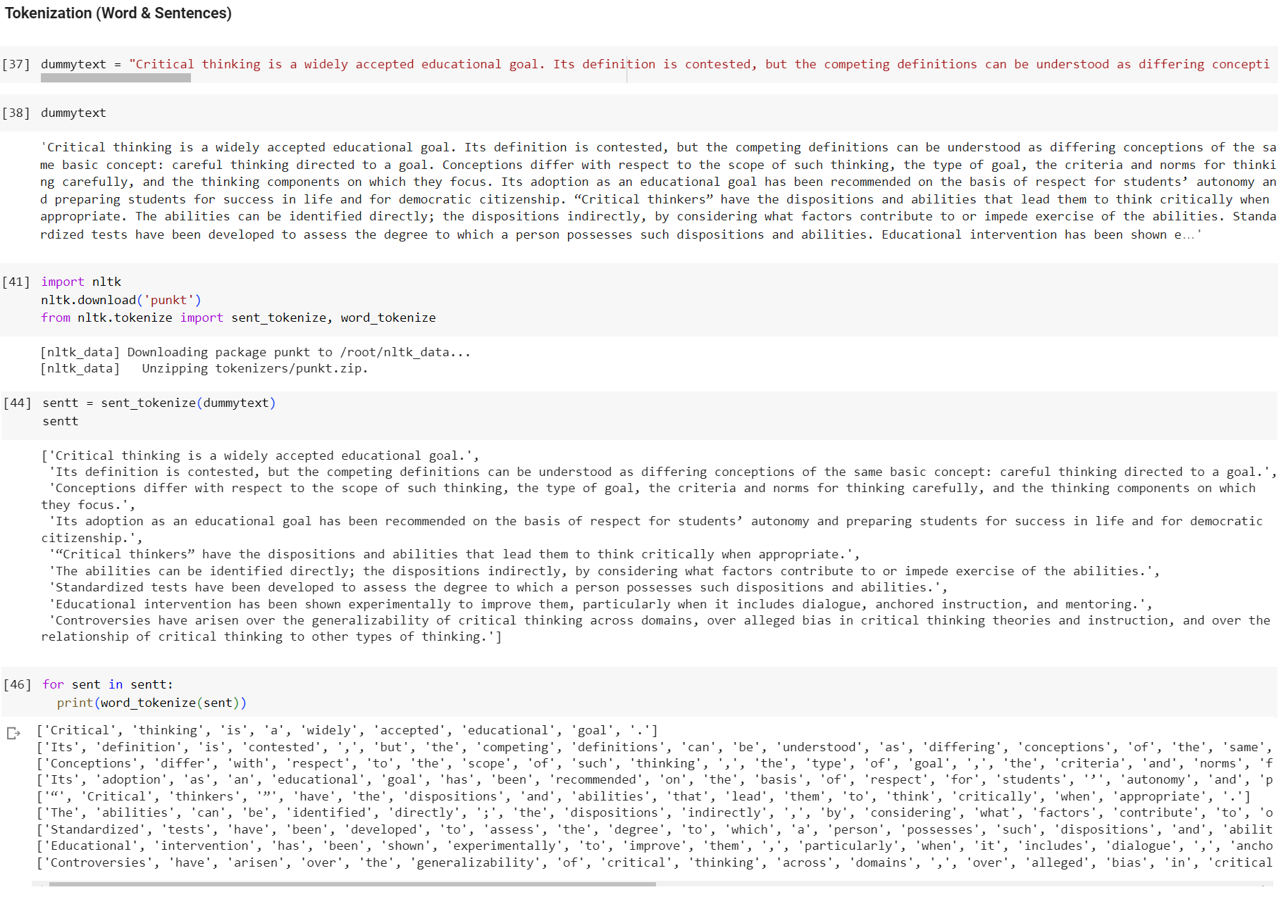
Notes:
NLTK (Natural Language Toolkit) is a Python library for NLP (Natural Language Processing). It provides tools to work with text, including tokenization, stemming, lemmatization, POS tagging, parsing, and more.

Slide 31
Text Preparation
Cleansing
HTML Tags Removal
Emoji
Basic Preprocessing
Advance Preprocessing
Spelling Checker
Basic
Optional
Tokenization
Stopword Removal
Stemming
Removing Punctuation, Digits
Lower Casing
Language Detection
Word
Sentence

Slide 32
Text Preparation
Cleansing
HTML Tags Removal
Emoji
Basic Preprocessing
Advance Preprocessing
Spelling Checker
Basic
Optional
POS Tagging
Parsing
Coreference Resolution
Tokenization
Stopword Removal
Stemming
Removing Punctuation, Digits
Lower Casing
Language Detection
Word
Sentence

Slide 33
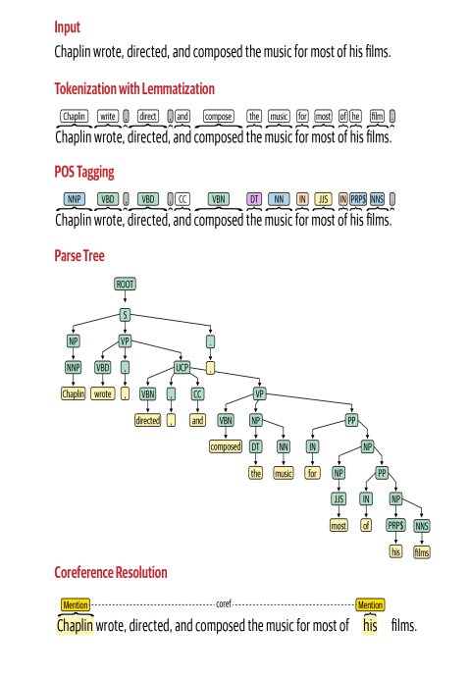
Notes:
1. Input
The original raw sentence is provided as input.
2. Tokenization with Lemmatization
Tokenization: Splits the sentence into words and punctuation tokens: [Chaplin] [wrote] [,] [directed] [,] [and] [composed] [the] [music] [for] [most] [of] [his] [films] [.]
Lemmatization: Converts words to their base form:
wrote → write
directed → direct
composed → compose
This helps normalize text for analysis.
3. POS Tagging (Part-of-Speech)
Each token is labeled with its grammatical category:
NNP → Proper noun (Chaplin)
VBD → Past tense verb (wrote)
VBN → Past participle verb (composed)
DT → Determiner (the)
NN → Noun (music)
PRP$ → Possessive pronoun (his)
NNS → Plural noun (films)
This step is useful for grammar understanding and further NLP tasks like parsing or NER.
4. Parse Tree (Syntactic Parsing)
Breaks the sentence into phrases (NP = noun phrase, VP = verb phrase, PP = prepositional phrase).
The hierarchical tree shows relationships:
Chaplin (subject) → performed actions (wrote, directed, composed).
Actions → connected with objects (the music).
Modifier phrases (for most of his films) describe context.
Parse trees are key for syntax-based tasks like machine translation or grammar checking.
🔹 5. Coreference Resolution
Identifies that “his” refers back to “Chaplin”.
Links pronouns and entities → makes text more coherent for machines.
👉 Example: Helps in text summarization, chatbots, and question answering systems.
✅ Summary: This pipeline demonstrates the progression from raw text → structured, machine-readable linguistic representation. Each stage adds more understanding:
Tokenization & Lemmatization → Words normalized
POS Tagging → Grammar roles identified
Parsing → Sentence structure mapped
Coreference Resolution → References clarified

Slide 34
Feature Engineering
Machine Learning
Deep Learning
Text Representation
Converting your text into numbers

Slide 35
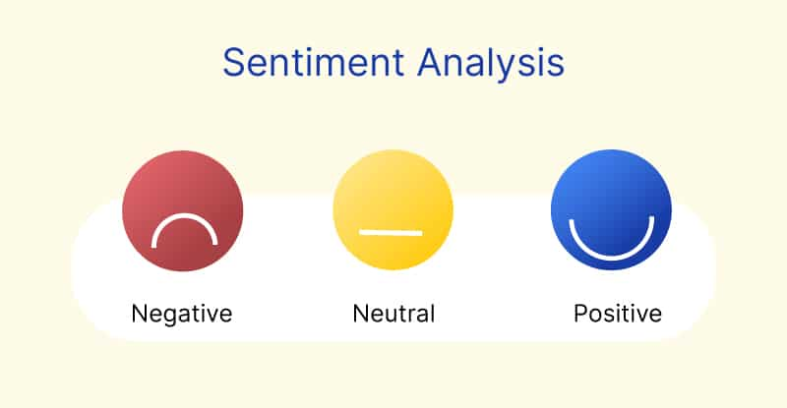
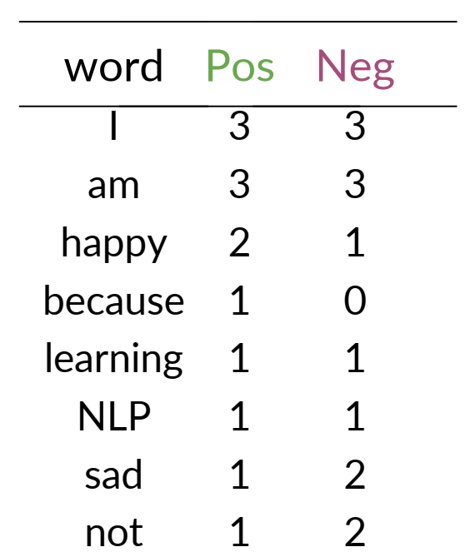
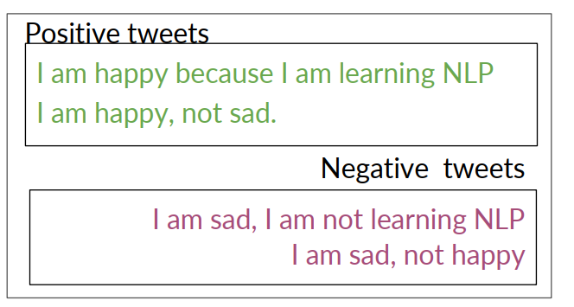
Over 50000 tweets
…
…
…
…
…
… … …
… … …
… … …

Slide 36
Modelling
Apply Model
Heuristic
Machine Learning
Evaluation
Deep Learning
CloudAPI
Amount of Data
Nature of Problem
Notes:
Apply Model
Different approaches depending on amount of data and nature of the problem:
Heuristic: Rule-based methods (e.g., keyword matching, pattern rules).
Machine Learning: Traditional ML models (e.g., Naive Bayes, SVM, Logistic Regression).
Deep Learning: Neural networks (e.g., RNNs, LSTMs, Transformers like BERT, GPT).
Cloud API: Pre-trained APIs (e.g., Google Cloud NLP, AWS Comprehend, Azure Text Analytics).

Slide 37
Modelling
Apply Model
Heuristic
Machine Learning
Evaluation
Deep Learning
Intrinsic Evaluation
CloudAPI
Extrinsic Evaluation
Technical Criteria (Metric)
Business Criteria
Amount of Data
Nature of Problem
Notes:
Apply Model
Different approaches depending on amount of data and nature of the problem:
Heuristic: Rule-based methods (e.g., keyword matching, pattern rules).
Machine Learning: Traditional ML models (e.g., Naive Bayes, SVM, Logistic Regression).
Deep Learning: Neural networks (e.g., RNNs, LSTMs, Transformers like BERT, GPT).
Cloud API: Pre-trained APIs (e.g., Google Cloud NLP, AWS Comprehend, Azure Text Analytics).
2. Evaluation
Models must be evaluated before deployment. Evaluation is split into Intrinsic and Extrinsic:
Intrinsic Evaluation (Technical Criteria)
Direct model performance metrics:
Accuracy
Precision, Recall, F1-score
Confusion Matrix
Extrinsic Evaluation (Business Criteria)
Measures impact on end-user or business goals:
Does the model improve customer satisfaction?
Does it reduce response time?
Does it help automate tasks and cut costs?

Slide 38
Deployment
Deploy
Monitoring
Update

Slide 39


